Slide 1


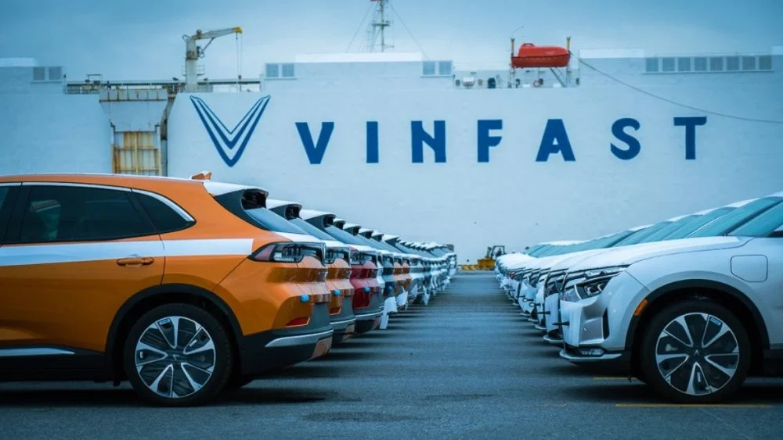

VINFAST
Home
Jobs
Apply
About
CAREERS AT VINFAST
Open Positions
Build the future of digital retail with us.
Four roles across web development, merchandising, data and customer experience. Ho Chi Minh City / Remote.
Applications close Friday, 09 October 2026
Home > Jobs
About Our Roles
Spot recruitment scams
Developingweb interfaces, product and catalogue data, sales analytics and customer communication, quoted by reference number, from VF001 to VF004 on the application form.
  A real application never asks for a fee.
  Never share bank details or one-time codes in an application.
  Check that the reference number matches the job listed on this page.
  Report suspicious messages using the email in the footer.
VF001: Software & Web Development
VF002: Product & Retail Merchandising
VF003: Data & Analytics
VF004: Customer Service & Operations

Slide 2

Software & Web Development
VINFAST
Builds the web interfaces customers use to configure and order vehicles.
E-Commerce UX/UI Front-End Developer
VF001
APPLY NOW
Team:
Digital Retail UI Team
Reports to:
Lead Digital Retail Architect
Work mode:
Hybrid (Ho Chi Minh City / Remote)
Type and hours:
Full-Time, flexible hours (core hours 10:00 AM - 4:00 PM ICT)
Salary:
30,000,000 - 40,000,000 VND
About The Role
Design and develop responsive web interfaces for the digital retail platform. Combine visual prototyping with front-end engineering to optimize the vehicle purchasing journey
Key responsibilities:
Essential requirements:
  Create wireframes and interactive prototypes in Figma for vehicle configurations.
  Build responsive web interfaces for vehicle configuration and online ordering.
  Maintain web accessibility standards (WCAG) across all customer-facing retail pages.
  Implement loading states and performance budgets to optimize page speed.
  Integrate interfaces with order, payment and inventory APIs, minimising third-party dependencies.
  Bachelor's degree in Computer Science, Software Engineering, Design, Human-Computer Interaction, or a related field.
  Minimum 3 years of commercial experience in front-end development or UX/UI design.
  Expert-level proficiency in Figma.
  Strong proficiency in semantic HTML5, CSS3, and core JavaScript.
  Practical knowledge of web accessibility standards and ARIA practices.
Preferable criteria:
Performance goals:
  Professional working proficiency in English (IELTS 6.0 equivalent or higher)
.
  Experience with modern front-end frameworks (such as React or Vue.js).
  Familiarity with secure data handling practices for online checkout systems.
  Previous experience in e-commerce or automotive digital retail platforms.
  Performance goals:
What success looks like in this role
60-day outcome:
Deliver reusable checkout and configurator components with zero critical errors in an accessibility audit.
90-day outcome:
Raise vehicle-configurator completion rate by 15%
Benefits:
Equal opportunity:
Comprehensive health insurance, flexible working hours, and employee discounts on eligible company products.
  Our commitment to every applicant.
  VinFast Digital Retail is an equal opportunity employer, considering candidates regardless of gender, age, ethnicity, religion, or disability.
Applications close Friday, 30 October 2026
APPLY FOR VF001
Use reference VF001 on the application form.

Slide 3
Digital Merchandising & Catalogue Specialist
VINFAST
Manage digital product displays and catalogue data across VinFast’s online retail platform
Digital Merchandising & Catalogue Specialist
VF002
APPLY NOW
Team:
E-Commerce Operations Team
Reports to:
Head of Digital Merchandising
Work mode:
Hybrid (Ho Chi Minh City / Remote)
Type and hours:
Full-Time, flexible hours (core hours 10:00 AM - 4:00 PM ICT)
Salary:
15,000,000 - 25,000,000 VND
About The Role
Ensure vehicle listings and accessories for models like the VF 2 are accurate and positioned to maximise online sales.
Key responsibilities:
Essential requirements:
  Maintain accurate pricing, specifications, and imagery for digital vehicle and accessory listings.
  Structure catalogue data in the CMS and keep product tags and compatibility attributes correct.
  Conduct weekly audits of product detail pages to correct data discrepancies.
  Coordinate storefront layouts and promotional campaigns for accessories and upcoming launches.
  Run A/B tests on product detail pages to identify effective merchandising layouts.
  Bachelor's degree in Business, Marketing, E-Commerce, or a related field.
  Minimum 2 years of experience in e-commerce catalogue management or digital merchandising.
  Proficiency in Content Management Systems and Product Information Management tools.
  Ability to interpret sales and engagement data.
  Working knowledge of A/B testing methodologies.
Preferable criteria:
Performance goals:
  Professional working proficiency in English (IELTS 6.0 equivalent or higher).
  Experience managing complex automotive product variants.
  Understanding of SEO best practices for product pages.
What success looks like in this role
60-day outcome:
Achieve at least 98% data accuracy in a catalogue audit of the VF MPV 7.
90-day outcome:
Raise accessory conversion rate by 12% through layout adjustments.
Benefits:
Equal opportunity:
Comprehensive health insurance, flexible working hours, and employee discounts on eligible company products.
  Our commitment to every applicant.
  VinFast Digital Retail is an equal opportunity employer, considering candidates regardless of gender, age, ethnicity, religion, or disability.
Applications close Friday, 30 October 2026
APPLY FOR VF002
Use reference VF002 on the application form.

Slide 4





VINFAST
Home
Jobs
Apply
About
How to Apply
Spot Scams
Note the Reference
No Fees: Real applications never ask for money.
Use the exact 5-character code.
Submit Before Deadline
No Details: Never share bank details or codes.
Friday, 30 October 2026.
Verify: Check reference numbers match.
VinFast Digital Retail is an equal opportunity employer.
VINFAST
Jira Project
Move Forward Together
GitHub Repository

